Slide 1
数字员工洞察参考
2021.5
Min He
Yonghua Cao
Shaojun Fu
All information comes from public source and for public consumption

Slide 2
Outline
数字员工基本概念和发展历程
数字员工的主要业界应用
数字员工能力提供企业案例
数字员工使用企业案例
数字员工商业模式
为什么要用数字员工来包装自动化能力？
数字员工融合策略和思考
数字员工的管理
数字员工技术栈
数字员工能力分级
网络管理数字员工和ADN的关系

Slide 3
数字员工基本概念

Slide 4
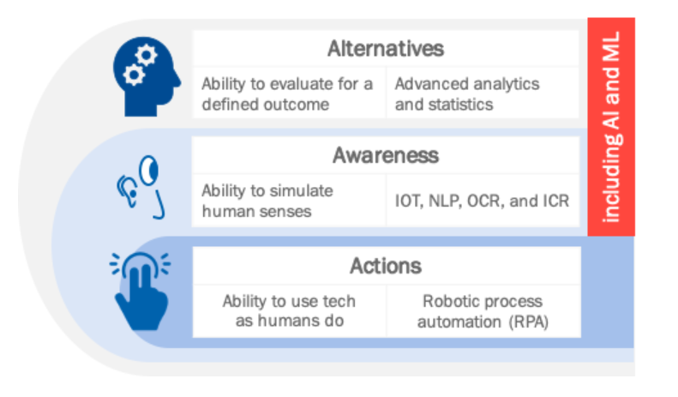


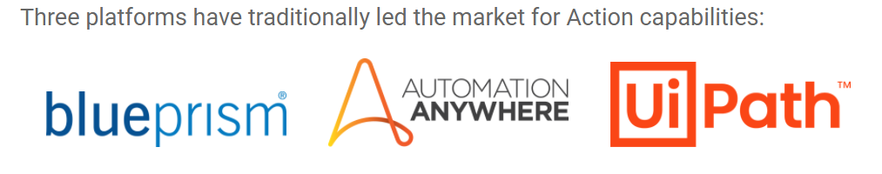
数字员工定义
An automated, software-based tool, application, or agent that performs a business task or process similar to a human user and uses AI or other autonomous decision-making capabilities.
An automated team member trained to carry out a business process just like any employee, only faster and without mistakes. All teams will have digital workers alongside humans in the future.
Advanced Digital Worker
+ Autonomy
https://wonderbotz.com/rpa-at-work/key-rpa-technologies/

Slide 5


Digital Worker
What
Definition
Why
Business scenario-based
More natural HMI
Capability as a charging unit
Better social-technical design principle
How
Governance/Security
Enabling Technologies
Life Cycle Management
Create, test, commission, modify, de-commission
Eco-system/marketplace
Where
Application Area in ADN
When
Relationship with ADN Level
Human Actor

Slide 6

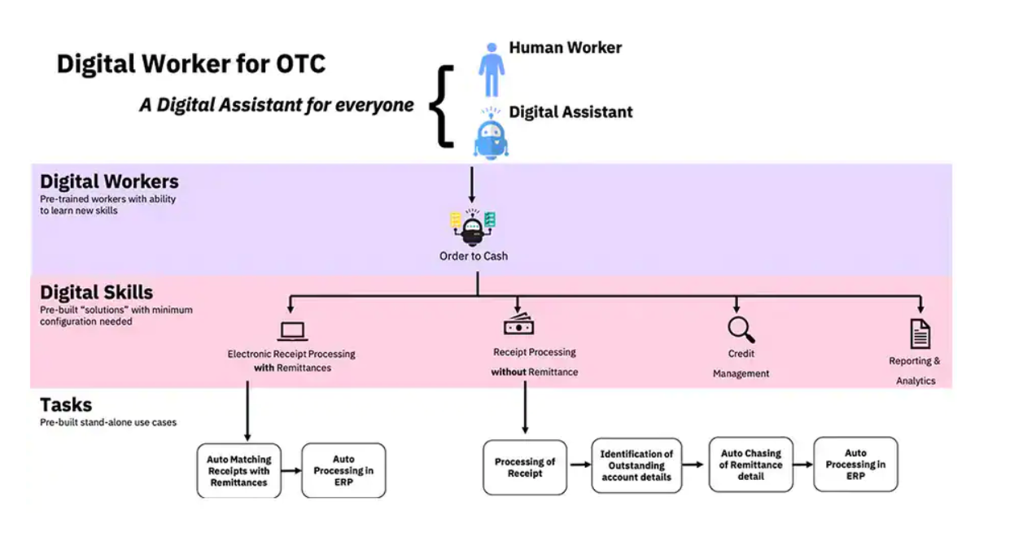
数字员工的特征
数字员工
承担特定角色 （Roles）
拥有特定技能 （Skills）
完成特定业务或商业场景（scenarios）
处理信息
执行任务
拟人工作方法
更高效，少错误，全时段，（Fewer errors， Operate 24x7)
协同能力，组成团队解决更复杂的问题， 随着工作量和工作要求，弹性灵活组合
可以给人类员工提供信息，增强能力（augment），支持和协助人类员工完全任务。
可以在复杂的企业环境中工作，达到安全性（Security），扩展性（Scalability）智能性（Intelligent） 和易用性（ease of use)的要求。
Documentation of a task becomes the actual task. Change the document change the task instantly. 数字员工具有敏捷（agile）， 安全（secure）和合规（compliance）
数字员工的一举一动全部有纪录，训练，修改，执行，参数，状态参数等等。使得更容易优化，理解行为，合规审计，责任鉴定。
IBM: What is Digital Worker
The evolution of the connected digital worker

Slide 7
数字员工特点What does digital worker do
WHAT DOES A DIGITAL WORKER DO?
Digital Workers are virtual employees that enhance and augment human work by combining AI, machine learning, RPA, and analytics to automate business functions from end to end.
Like a human employee
Digital Workers perform multiple tasks in sets of sequences, such as systematically and regularly submitting invoices from beginning to end.
Pre-built, downloadable, plug-and-play
They are designed as pre-built, downloadable, plug-and-play digital personas, linking curated software robots with transactional, cognitive, and analytical abilities to emulate and connect with human workers.
Learn & prioritize processes
Over time, Digital Workers can learn to prioritize certain business and IT processes, allowing them to operate in roles such as accounts payable or IT operations specialist with little to no supervision.
FUTURE OF WORK
=
Human + DIGITAL WORKER TEAM
=
HUMAN POTENTIAL LIBERATED
The workforce of the future will be a seamless blend of human and virtual employees, each enhancing the other’s strengths and abilities. Human workers will focus on innovation, adding value, and pursuing new skills.

Slide 8
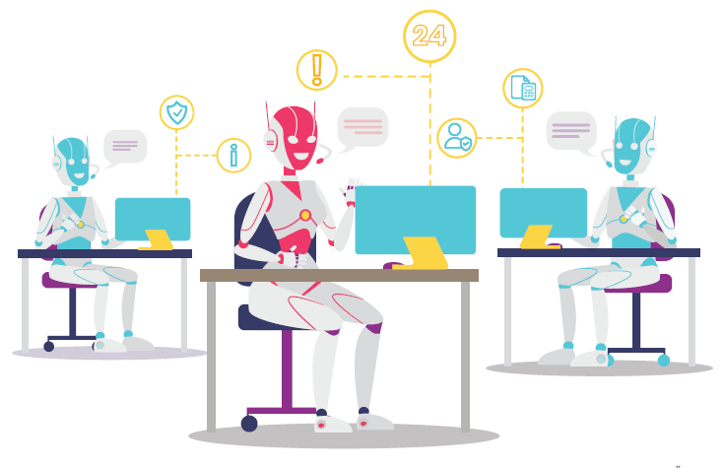
数字员工带来的机遇（Opportunities）
Higher efficiency, better productivity, Faster processing speed
Increased Quality, absolute accuracy
Easy to deploy, more accessible with cloud access
Easy to scale, increased flexibility and growth
Improve data accuracy, real time integration
Risk management and controls
Utilize the best practice
Enhanced customer experience
Reduce cost

Slide 9
数字员工挑战 (Challenges)
Not enough tasks to automate, making it difficult to justify the cost of a digital worker
Technology may struggle with some unstructured data sources and reasoning skills
Gathering information for documentation purposes can be costly and resource intensive
Scaling can be difficult if digital workers are not designed to be configurable and adaptable
Underline supporting system not enough intelligence and autonomy which hinder digital worker’s capability to deal with high ROI business scenarios.
https://www.ibm.com/cloud/learn/digital-worker

Slide 10
数字员工发展历程

Slide 11
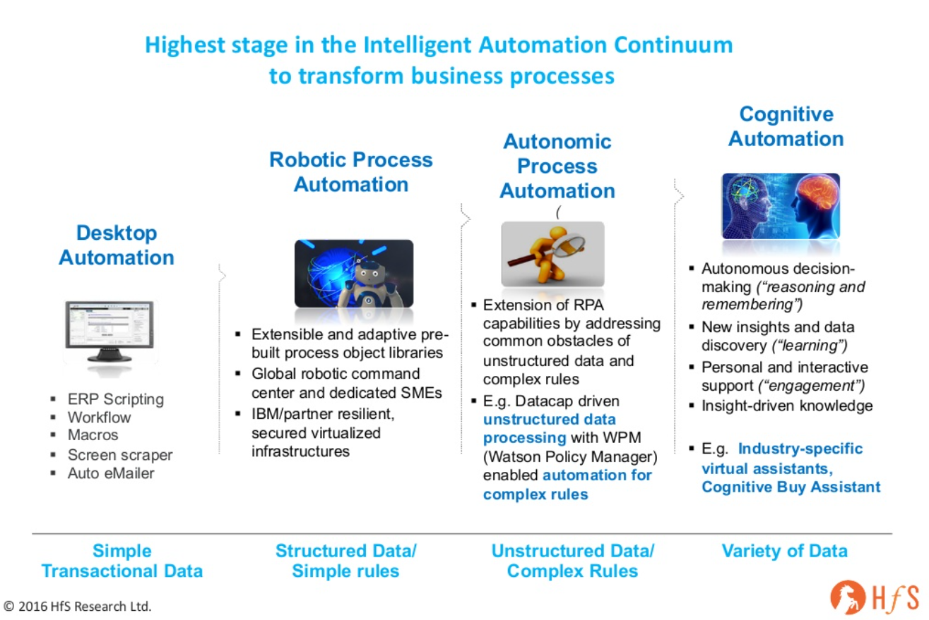
自动化发展历程
https://www.slideshare.net/HfSResearch/applying-cognitive-computing-to-business-operations-transforming-front-to-back-office

Slide 12
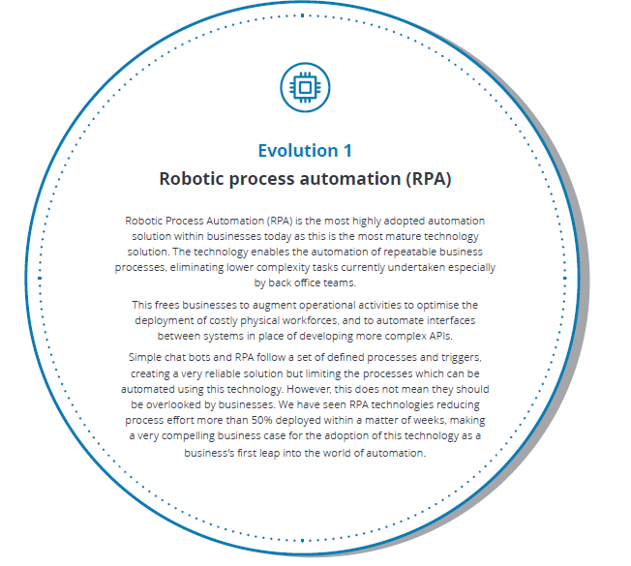
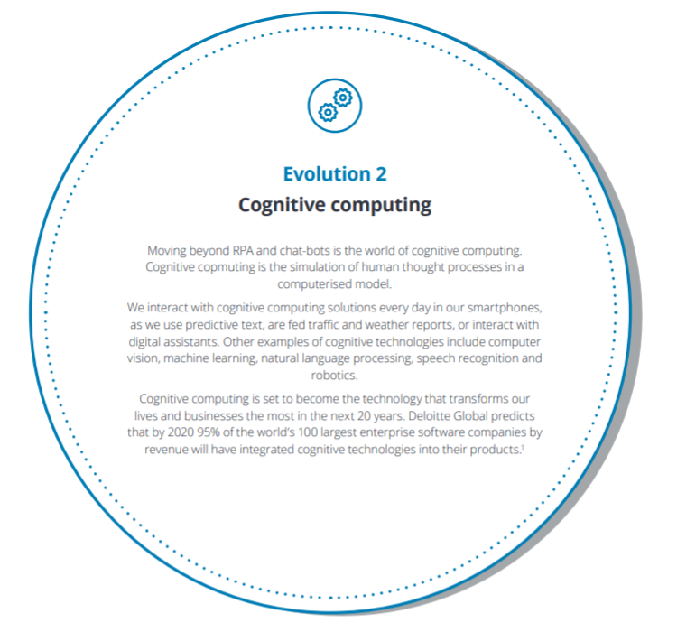
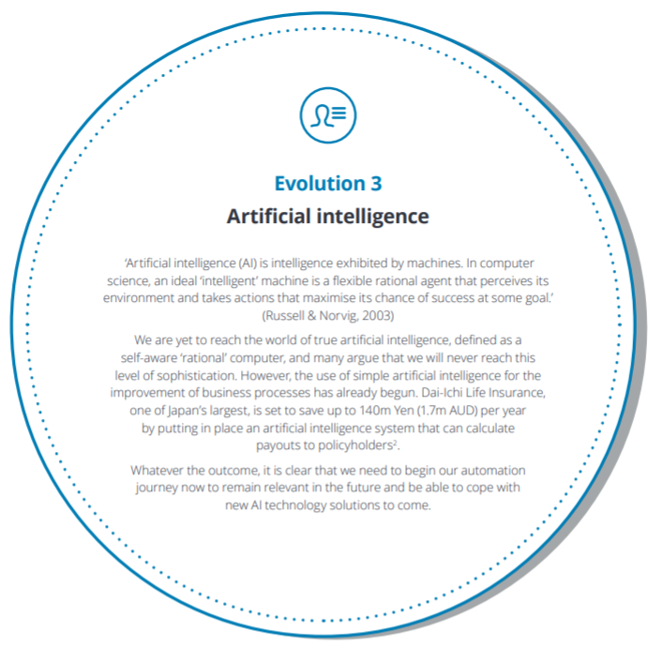
数字员工发展3个阶段
德勤 （Deloitte）
Managing Digital Workforce

Slide 13
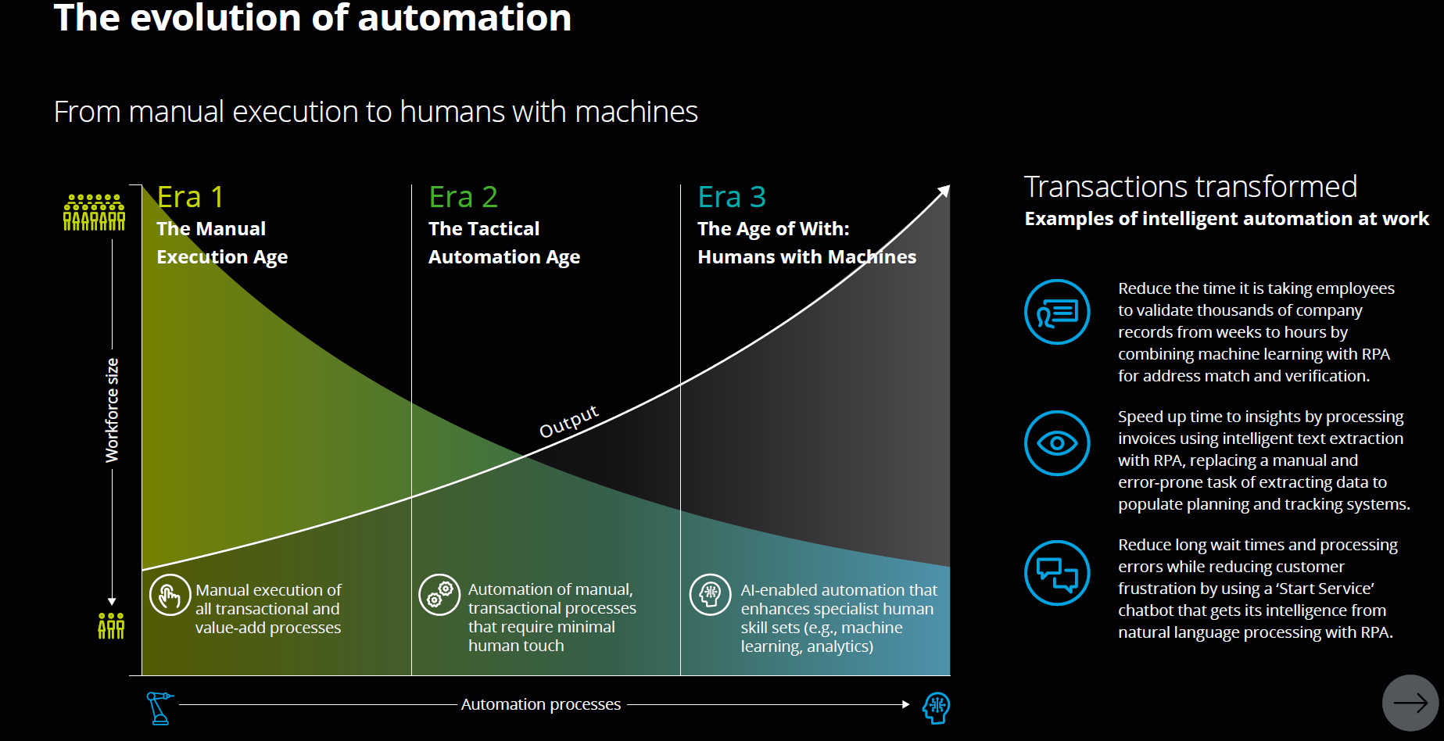

Slide 14
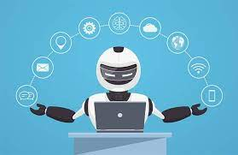
Automation Evolution
Efficiency Gain | Customer Experience | Input Data Processing | Security | Management and Control | Organization Impact
Very high | Very high | Very high | Very high | Very high | Very high
high | high | high | high | high | high
high | high | high | high | high | medium
medium | medium | medium | medium | high | medium
low | low | low | low | low | low
Digital Workforce
团队协同能力
SWARM intelligent
拟人行为,担当与人相似的某种角色
AI/ML广泛和深度应用
拥有高级能力:决策,推理能力,对话能力,自主能力,自学习，自适应能力
集中管理/生态系统
Digital Worker
IPA
+ AI/ML
能够处理semi Structure 输入数据,
+workflow
可以执行复杂流程
能够处理Structure输入数据,
集中管理, 以Bot或App方式呈现
有一定规模的生态系统
RPA
Desktop Record and Play， Scripts
离散
个人
ad hoc

Slide 15
RPA (bots) now → IPA (digital worker) next
RPA Robotic Process Automation
IPA Intelligent Process Automation
Software “robots” or “bots”
Good at
Repetitive tasks
Highly structured tasks
But limited by
Simplistic logic (e.g. rigid rule-based)
Unable to reason
Unable to make decisions
Lack scalability & security
Next phase of RPA
Software agent AI + RPA
Called Digital Worker
Human-like job roles & advanced capabilities
Visual understanding
Unstructured input understanding
Conversational interactions
Process-aware (user intent/pattern)
Planning & reasoning
Domain-specific skills (e.g. telco, netops)
Note: IPA is sometime regarded as RPA 2.0 or RPA 3.0.

Slide 16
Automation Evolution
Desktop Record and Play， Scripts
RPA
IPA
Digital Worker
Digital Workforce
Desktop Record and Play， scripts
RPA
IPA
Desktop Record and Play ，scripts
RPA
Desktop Record and Play ，scripts
团队协同能力
SWARM intelligent

Slide 17
数字的主要业界应用

Slide 18
数字员工的主要业界应用
行业
Banking
Health Care
Insurances
Government
Transport and Logistics
Education
BPO (Business Process Outsourcing)
Telecom
Manufacturing
工种
Customer Care
Sales and Marketing
HR
Legal
IT
Finance and Accounting
Automation Anywhere has deployed over 2.6 million bots to support some of the world's largest enterprises across all industries in more than 90 countries.
Bot Store has over 1000 prebuilt-bot

Slide 19
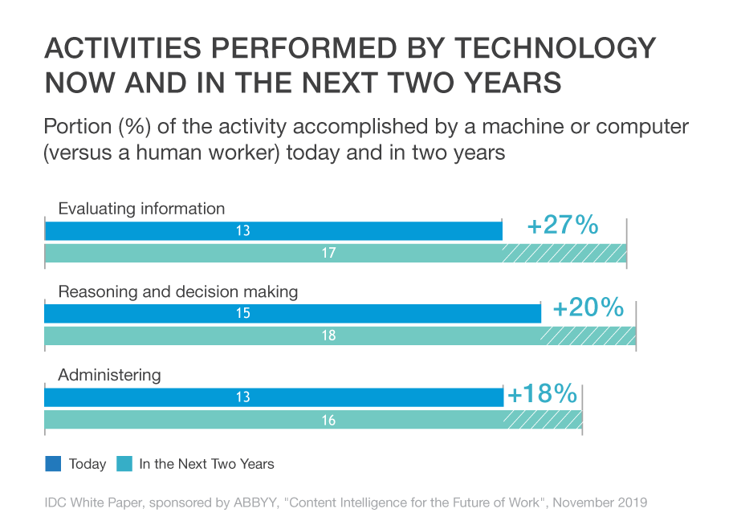
数字员工已经部署而且高速发展 （Digital workers are spreading rapidly worldwide）
IDC 2019调查： 数字员工部署两年内会增加50%
IDC Whitepaper “Content Intelligence for the Future of Work” 2019 :
“The contribution of software robots, or digital workers, to the global workforce will increase by over 50% in the next two years. These results, from a survey of 500 senior decision-makers in large enterprises in the US, Canada, the UK, Germany, France, and Australia, illustrate a fundamental shift to a future of work dependent on human-machine collaboration.”

Slide 20
数字员工能力提供企业案例

Slide 21
两类厂商提供通用数字员工产品
RPA 厂商
AI 厂商
Digital Worker = Bots + AI
Digital Worker = AI + Bots

Slide 22
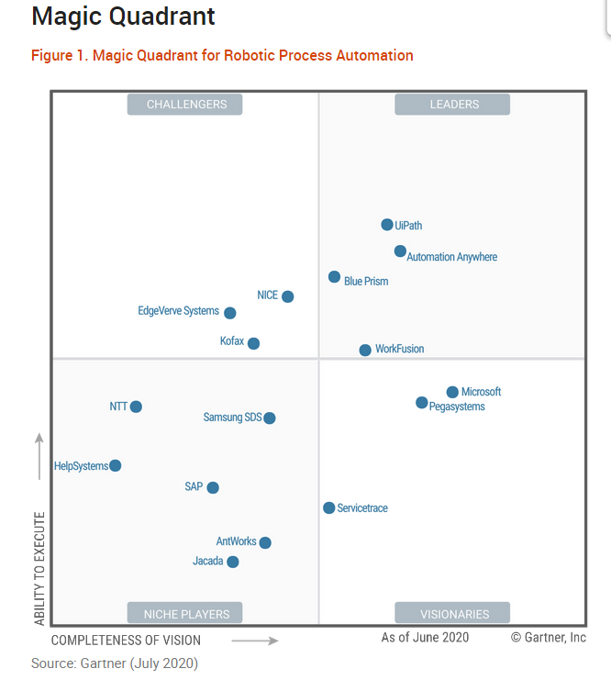
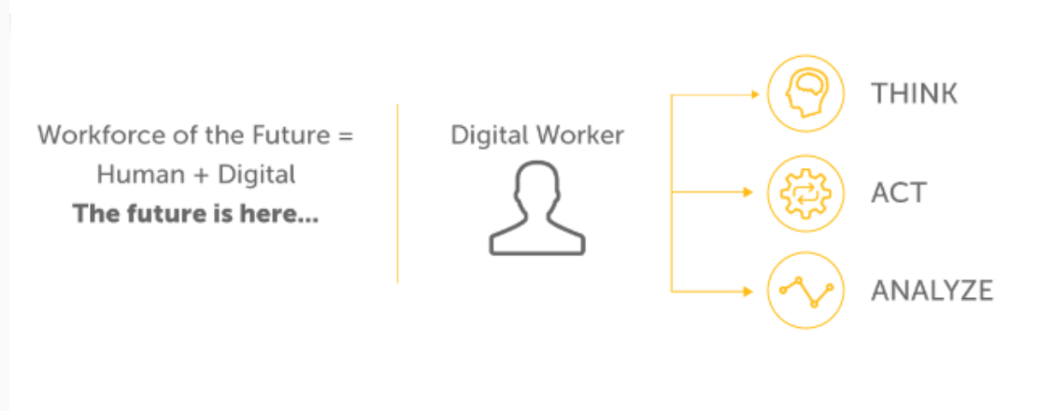
主要RPA厂商都把数字员工作为RPA发展的下一个阶段
Gartner finds that the 10 largest RPA software vendors account for over 70% of market share in the RPA market.
DIGITAL WORKER is advanced form of Bots
Bots—software robots—are task-centric; Digital Workers are built to augment human workers by performing complete business functions from start to finish. For example, a Digital Worker can take on the work of regularly submitting invoices through the system from beginning to end.
Rely on a bot to automate a task. Rely on a Digital Worker to enhance any job role.
Gartner： 2021 Magic Quadrant for Robotic Process Automation

Slide 23
RPA (bots) now → IPA (digital worker) next
RPA Robotic Process Automation
IPA Intelligent Process Automation
Software “robots” or “bots”
Good at
Repetitive tasks
Highly structured tasks
But limited by
Simplistic logic (e.g. rigid rule-based)
Unable to reason
Unable to make decisions
Lack scalability & security
Next phase of RPA
Software agent AI + RPA
Called Digital Worker
Human-like job roles & advanced capabilities
Visual understanding
Unstructured input understanding
Conversational interactions
Process-aware (user intent/pattern)
Planning & reasoning
Domain-specific skills (e.g. telco, netops)
Note: IPA is sometime regarded as RPA 2.0 or RPA 3.0.

Slide 24
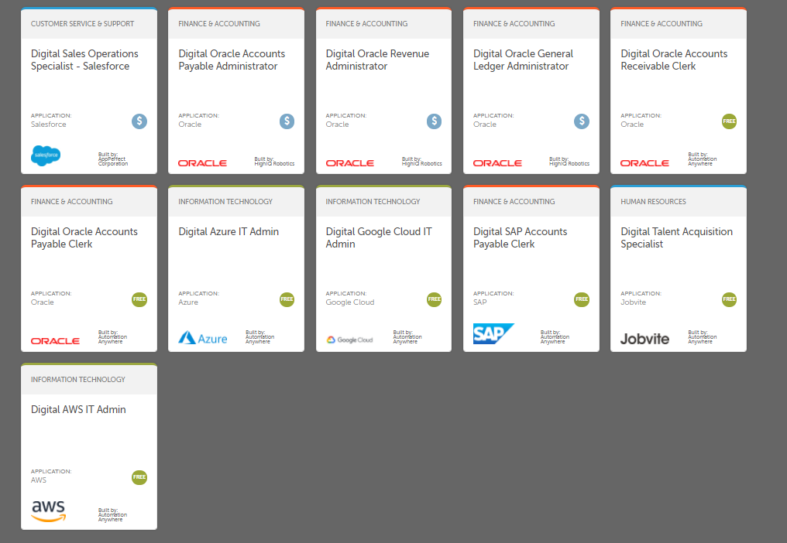

数字员工市场 Digital Worker Market Place Example: Automation Anywhere
https://botstore.automationanywhere.com/digital-workers#about-digital-workers

Slide 25


AI 厂商也提供数字员工
Amelia Digital Worker Market Place
https://www.ibm.com/cloud/cloud-pak-for-business-automation

Slide 26
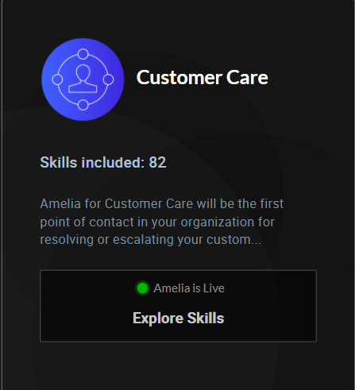
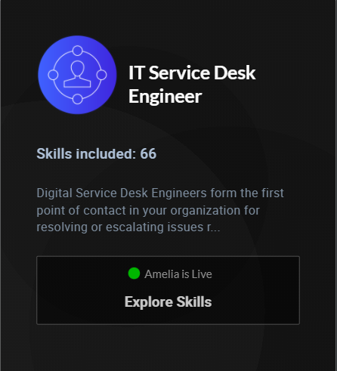
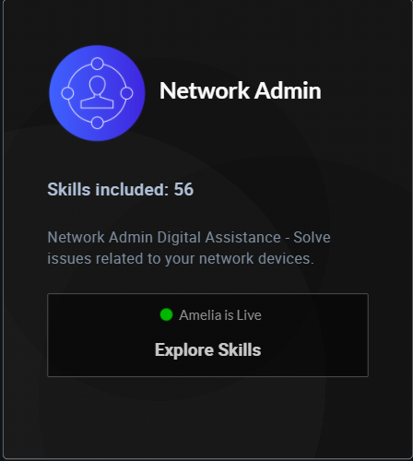
数字员工角色案例： Amelia ITSM Digital Workers

Slide 27
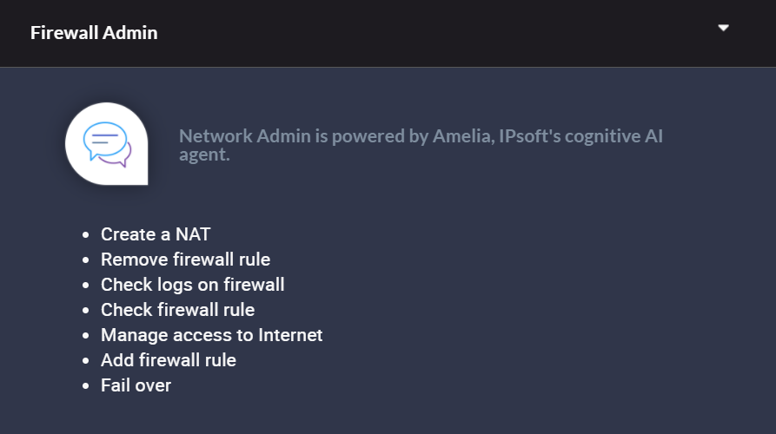
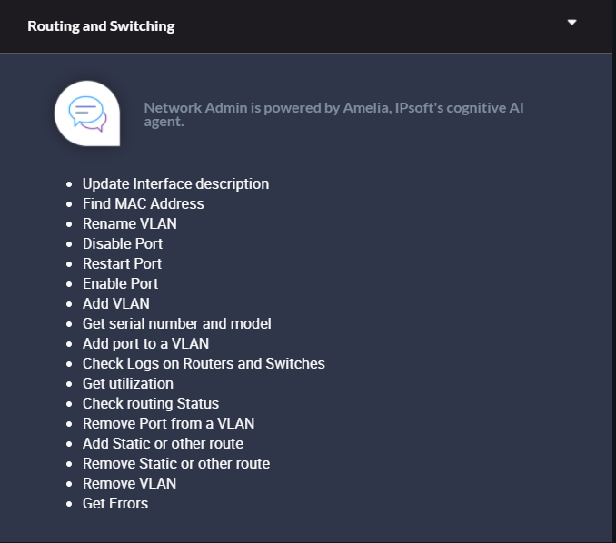
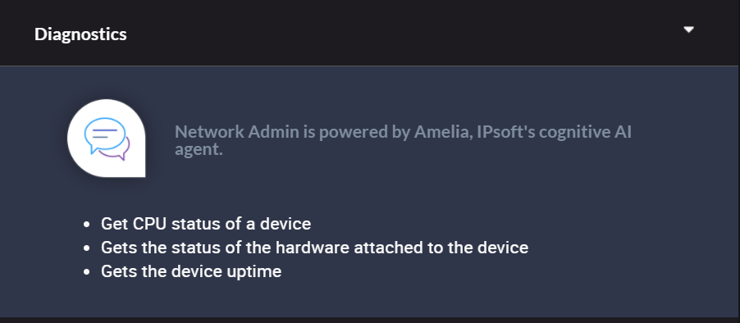
数字员工技能案例：Amelia 网络管理员

Slide 28
Amelia 数字员工角色样本
Cisco Networking Manager
Device Healthcheck Expert
Device Inventory Manager
Device Uptime Specialist
Firewall Fallover Expert
Firewall Access Administrator
Network Interface Manager
Network Configuration Manager
Network Troubleshooter
Port Setting Administrator
Port Switch Expert
Vlan Administrator
Vlan Configuration Manager
Vlan Modification Expert
Vlan Port Removal Associate
Vlan Removal Expert
VPN Specialist
VPN Troubleshooter

Slide 29
数字员工使用

Slide 30
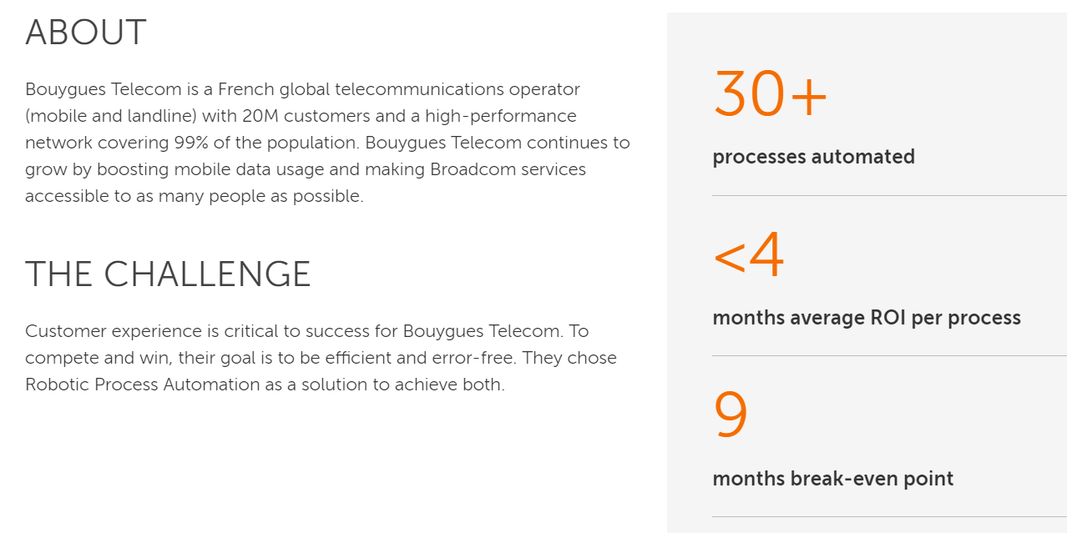
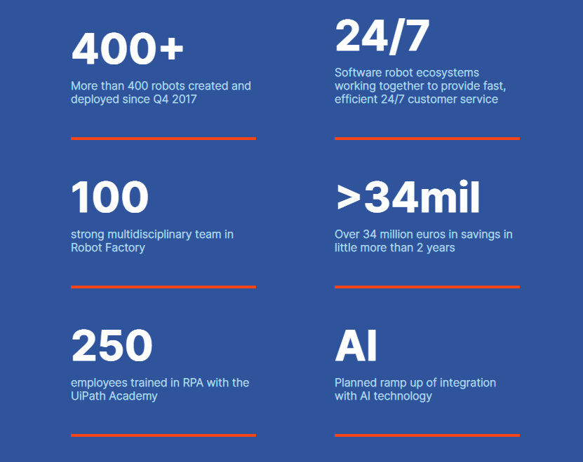
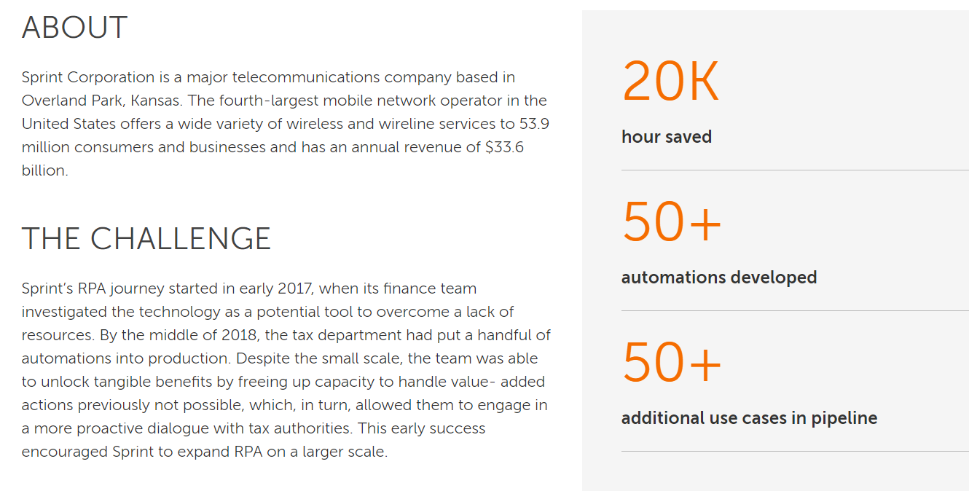
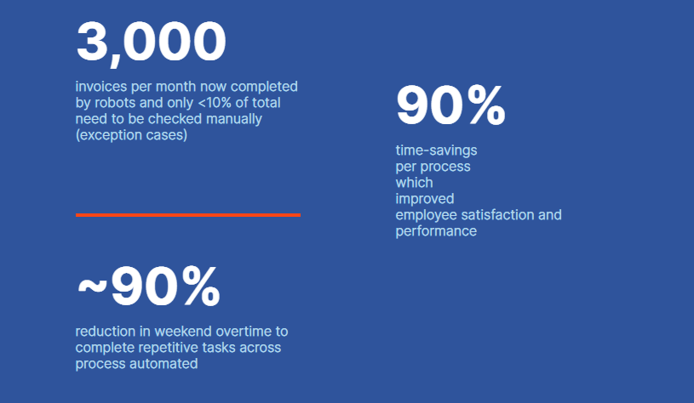
数字员工使用效果案例
Bouygues telecom automates 30 processes for €10M annual savings
Orange Spain deployed 400+ bots, 34m euros in savings
Sprint automates 50+ processes, gain 20k hour saving
Telkomsel 90% reduction in weekend overtime for invoice processing

Slide 31
数字员工商业模式

Slide 32
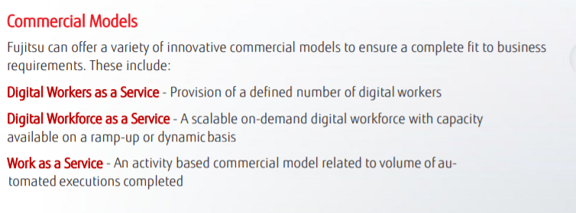

数字员工商业模式案例
Amelia IT Service Desk Engineer

Slide 33
Digital Worker vs RPA
RPA is one part of the Digital Workforce equation. Like humans, Digital Workers blend multiple skill sets. RPA is essential for execution, but Digital Workers require AI and embedded analytics too. Digital Workers are made possible by the RPA platform that is architected for the Digital Workforce of both the present and future.
Error-free execution of structured business processes
Self-improving automation using AI and machine learning for complex data
Real-time operational and business intelligence ready to be applied, right away
A digital worker is software designed to model and emulate human job roles by performing end-to-end job activities using automation and AI-based skills. In contrast, an RPA bot is software that mimics human actions by performing specific tasks for which it’s programmed.
Digital workers can understand, decide and act to automate job roles as opposed to simply acting to automate individual tasks. In doing so, they extend RPA capabilities and can be applied to more use cases
DIGITAL WORKFORCE PLATFORM
RPA+Cognitive automation+embeddd RPA analytics = digital workforce platform

Slide 34
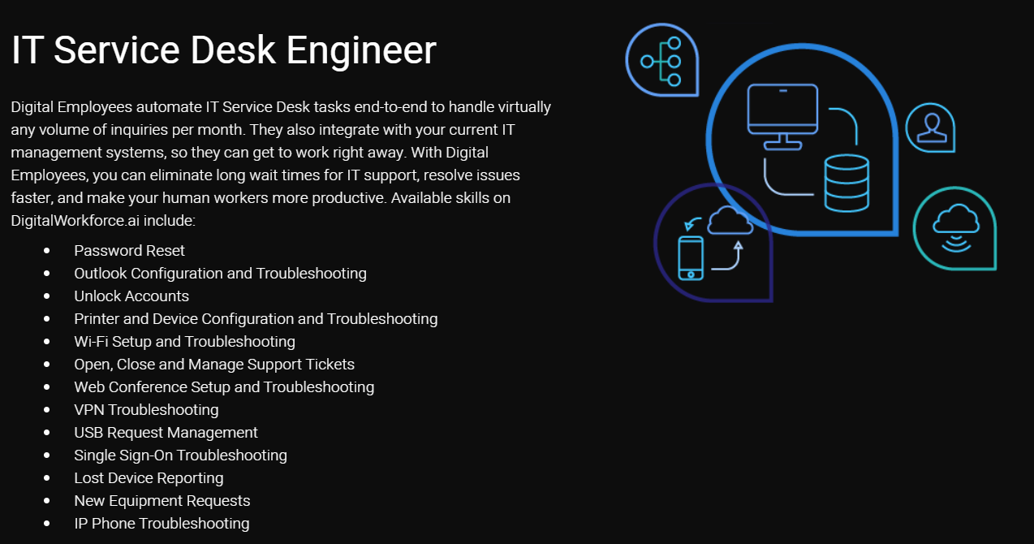
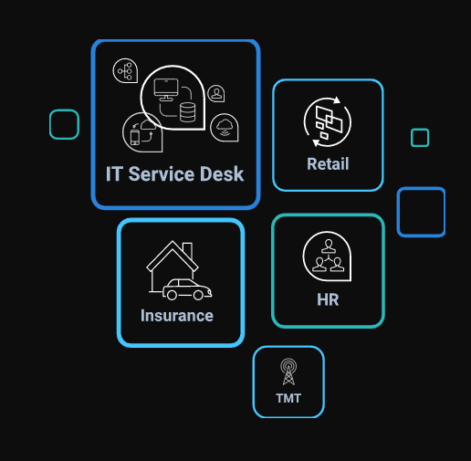
Example: IPSoft’s Amelia

Slide 35
各界对数字员工其他理解

Slide 36
数字员工不是简单的软件机器人
简单的桌面机 record/replay 的软件机器人不是数字员工。
缺乏整体管理，容易导致安全于合规风险
a single human user is given autonomy over a part of the technology estate, which introduces a lack control and creates multiple security and compliance issues。
The proliferation of desktop robots, if ungoverned without business oversight, means that organizations don't know where they exist, what processes they use and whether they are running or stopping unexpectedly.
如果与人使用同一个计算机资源，人的效率被拉低

Slide 37
为什么要用数字员工来包装自动化能力？

Slide 38
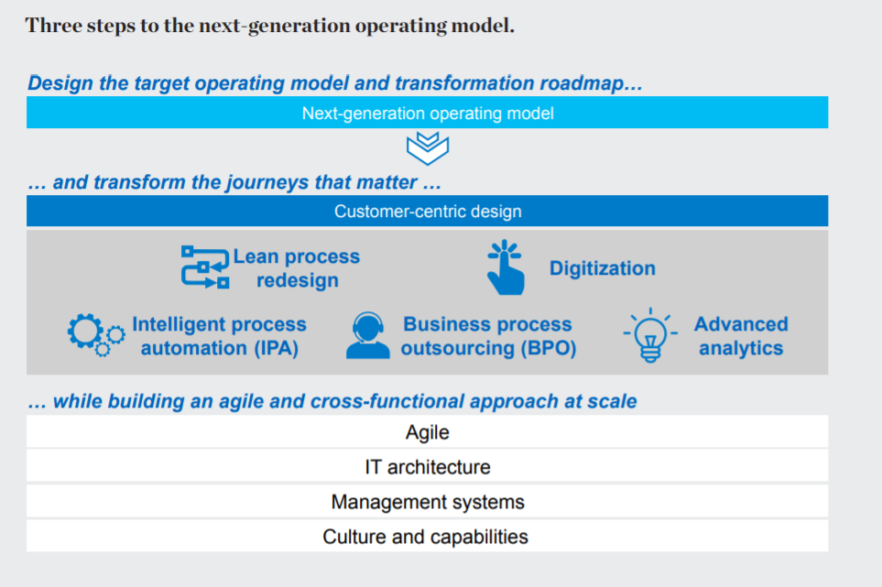
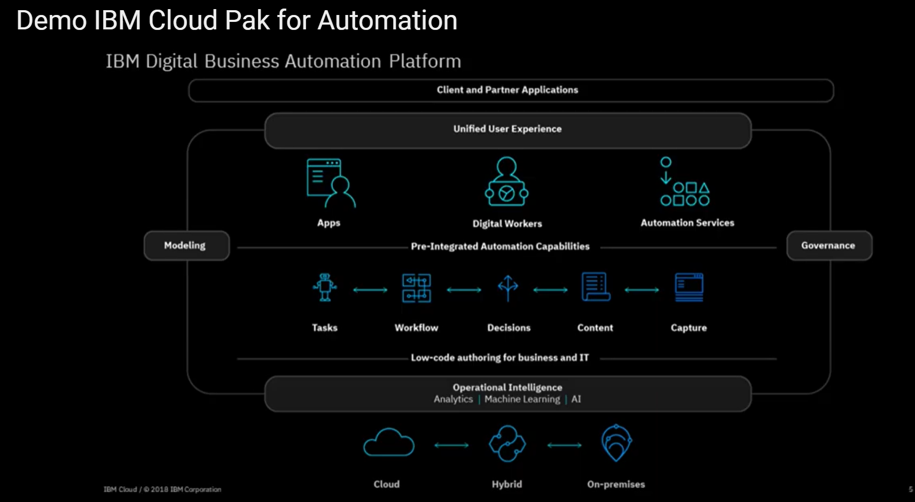
下一代运维模式的关键是以客户（人）为中心的设计
“ The Next-generation operating model is about customer-centric design” --- Mckinsey
Digital Worker is a conceptual framework for automating work and a technical framework for integrating a variety of intelligent services to carry out those goals.
Mckinsey on Digital Service : introducing-the-next-gen-operating-model

Slide 39
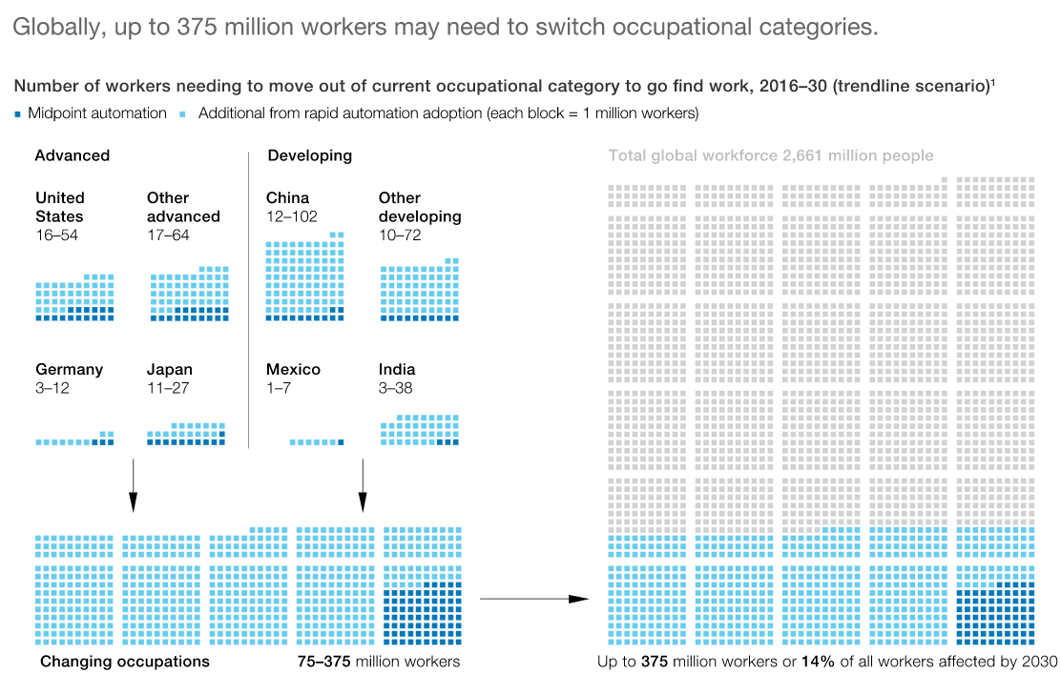
人机协同能够提高企业的生产力Human-Machine Collaboration
Humans-machines collaboration increases productivity hence revenue by 38% by 2022.
More than 80% of business leaders agree human-machine collaboration helps achieve strategic priorities.
1. Artificial Intelligence – Accenture Research (link)
2. Human + Machine Collaboration: Work in the Age of Artificial Intelligence – Interesting Engineering (link)
McKinsey report: 375m (14%) need to change jobs by 2030!
https://www.mckinsey.com/featured-insights/future-of-work/jobs-lost-jobs-gained-what-the-future-of-work-will-mean-for-jobs-skills-and-wages

Slide 40
数字员工高级能力给企业的赋能
数字员工能力 | 赋予企业能力
知识和洞察能力(Knowledge and Insight) The ability for digital workers to harvest information from different data sources, understand it and deliver previously unattainable insights, | 布局NLP （Deploy NLP） 通过洞察获取关键知识和信息（Gain Insight） 借力实时数据处理和分析能力（Leverage Realtime Analytics） 生产各种报表（Report metrics） 深度挖掘数据更好理解流程（Mine data for better understanding of the work flow process) 利用数据管理更高效分配数字员工
可视化能力 （Visualization） The ability to read, understand and contextualise visual information digitally, | Leverage optical character recognition so digital workers can work with text just like humans Use natural language processing to allow digital workers to understand & interpret human language Instantly analyse and understand the meaning of digital images via Computer Vision
学习能力 （Learning） The ability to derive contextual meaning from datasets, as well as recognize process | Leverage true machine learning to give digital workers the ability to “learn” without being programmed Prepare for the future as digital workers process information with a neural network paradigm Enable digital workers to model algorithms quickly.
计划和排序能力（Planning and Sequencing） The ability to optimally plan workflow and workload execution to deliver the best outcomes | Enable digital workers to instantly and intelligently manage workloads Let digital workers auto-scale as needed by business conditions. Use automatic process mining to analyse business processes, based on event logs
解决问题能力 （Problem Solving） The ability to solve logic, business and system problems without intervention | Use automatic problem detection to ensure the highest levels of service Possess problem solving ability to increase productivity throughout all processes. Achieve digital worker-enabled visualization to gain insight from data.
协同能力 （Collaboration） The ability to communicate and complete tasks with people, systems and other digital workers, | Use digital workers to reduce time to service customers and improve overall quality Empower employees to work with digital workers to elevate their roles and increase contributions Deploy chat bots to work with digital workers to autonomously service customers and escalate to humans when needed.

Slide 41
数字员工融合策略和思考

Slide 42
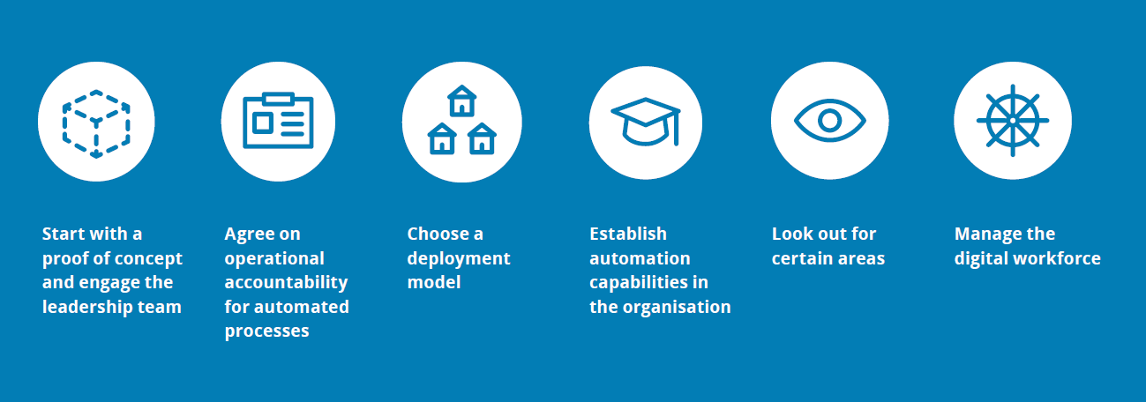
建立数字员工流程
德勤 （Deloitte）
Managing Digital Workforce

Slide 43
Digital Worker Integration Strategy 1/3 IBM Research Summary
Q1: Should I incorporate digital workers, and where?
Do carefully consider the cost of “hiring” digital workers.
Use careful cost-benefit analysis to establish ROI
Consider AI training & deployment costs, algorithm bias, etc.
Consider downsides of being “too automated” (LOA vs SA)
Do identify places in a workflow where a digital worker can help.
Stages in process that human workers struggle or with high performance variance
Do scale confidently by scale gradually.
Low-value, low-risk first; Always slow, small, but steady
Don’t assume digital workers can do everything.
Be aware of the limitations of digital workers (NLP imperfect etc.)
Do’s and Don’ts for Human and Digital Worker Integration, Vinod Muthusamy et al, IBM Research, 2020 (link)

Slide 44
Digital Worker Integration Strategy 2/3 IBM Research Summary
Q2: How should human & digital workers work together?
Do calibrate the initiative of digital workers.
Levels: no initiative (recommend bots) vs full initiative (fully autonomous)
Humans to decide (fine-tune) a digital worker’s initiative level (efficacy vs risks)
Do trust but verify.
Monitoring platform (e.g. ROC robot operation center)
In a hybrid team, human workers overrides digital workers.
Do empower human workers to improve their digital co-workers.
Provide human feedback to digital co-workers for them to learn.
Do make sure human workers understand their digital workers.
Human workers need to understand decisions made by digital worker
Leverage XAI (Explainable AI) technologies; enhance human trust for digital workers
Do’s and Don’ts for Human and Digital Worker Integration, Vinod Muthusamy et al, IBM Research, 2020 (link)

Slide 45
Digital Worker Integration Strategy 3/3 IBM Research Summary
Q3: How to evaluate the combined human-digital workforce?
Don’t directly compare performance of human & digital workers.
Avoid comparing simplistic metrics between human & digital (not a competition!)
Encourage human workers to do high-value complex tasks
Use A/B tests to decide who is better overall for a specific task
Do establish a holistic performance scoreboard of the hybrid team.
Usual: performance (AHT, backlog), quantity (accuracy, revenue, …)
Also consider: overall process outcome, employee & customer satisfaction etc.
Also consider: human overrides (A bad digital worker is a hinderance!)
Do capture the interaction patterns between human and digital workers.
Use analytics to understand human-machine collaboration and optimize process
Don’t consider only quantitative metrics when evaluating hybrid teams.
Also consider how digital workers help reduce human workers’ workload, stress, job satisfaction, engagement, etc.
Do’s and Don’ts for Human and Digital Worker Integration, Vinod Muthusamy et al, IBM Research, 2020 (link)

Slide 46
数字员工的管理

Slide 47
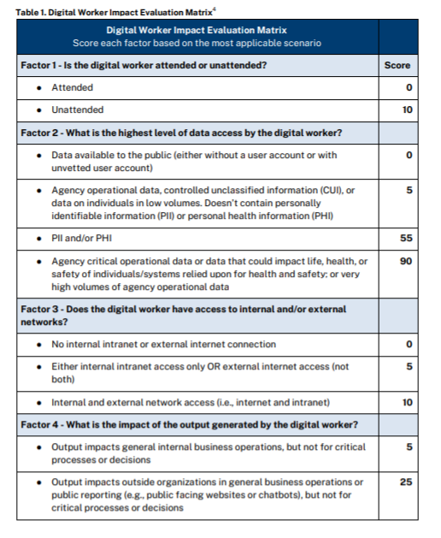
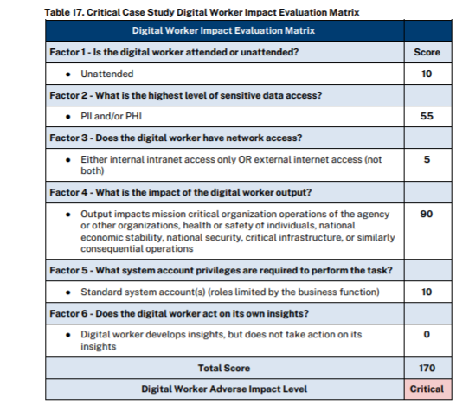
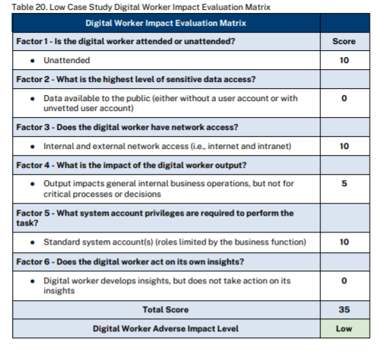
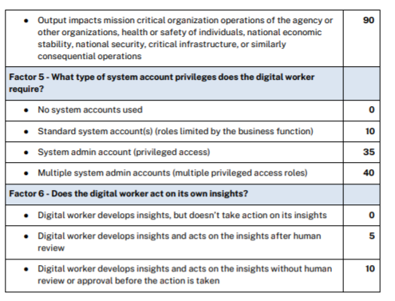
评估数字员工安全性影响Digital Worker Impact Evaluations
Factor 1 – Is the digital worker attended or unattended? This factor assesses whether the digital worker is attended and overseen by a human worker in completing its operations
Factor 2 – What type of data does the digital worker access? This factor assesses the impact-based sensitivity of data accessed by the digital worker to determine the potential adverse impact related to unauthorized disclosure of information and changing or destruction of information.
Factor 3 – Does the digital worker have access to internal and/or external networks? This factor assesses what type of networks the digital worker accesses. There are different levels of potential impact depending on whether access is granted to internal networks, external networks, or both.
Factor 4 – What is the impact of the output generated by the digital worker? This factor assesses the potential worst-case scenario impact of the output the digital worker generates on different stakeholder groups: internal organizational impact; external organizational impact; and critical, pervasive impacts across organizations, government, or society.
Factor 5 – What type of system account privileges does the digital worker require? This factor assesses the type and level of system account access that the digital worker requires to complete its tasks. Privileged access, especially for multiple systems, creates higher potential adverse impact than standard user accounts or no account use at all.
Factor 6 – Does the digital worker act on its own insights? This factor assesses the extent to which a human is involved in approving the decisions of digital workers. Digital workers that generate insights and then use those insights to make decisions or complete actions are seen as having a greater potential adverse impact compared to digital workers that only generate insights or that generate insights but have a human review before completing a subsequent action

Slide 48
数字员工技术栈

Slide 49
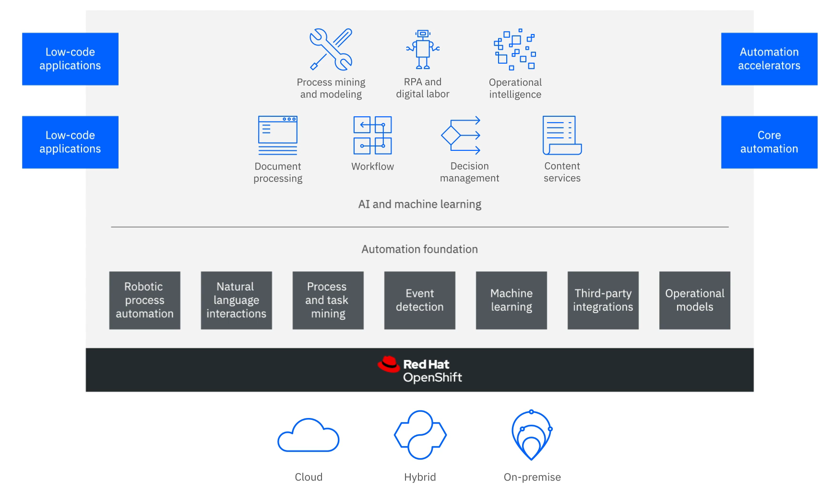
IBM Cloud Pak Architecture
Consolidated IBM content management, decision management, and process automation offerings
Modularized components covering BPM, RPA and LCAP
Integrated IBM's Watson AI capabilities
Easy to build into existing systems and scale on cloud
Deep partnership with Automation Anywhere and UiPath for RPA support.

Slide 50
Digital Worker
Digital worker should be part of an organization’s overall digital transformation strategy
Digital workers can work as individuals or in a workforce
Intelligence level of digital worker can evolve

Slide 51
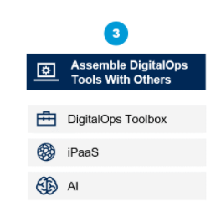
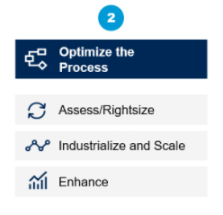
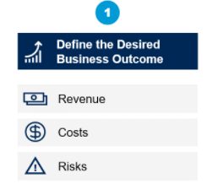
Roadmap to E2E Intelligent Process Automation
E2E IPA – Long-term integrated strategy
Align business goals, identify processes to optimize and choose complementary technologies
Source: Gartner “Move Beyond RPA to Deliver Hyperautomation” Dec 2019

Slide 52

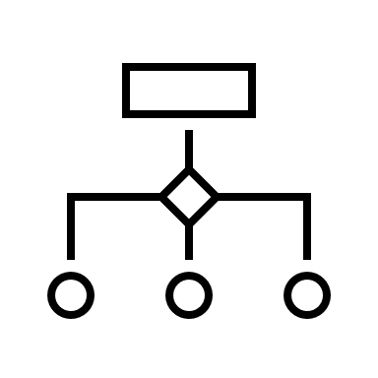

Multiple Products – Competing/Collaborative?
RPA
Robotic Process Automation
Providing quick relief as a noninvasive form of integration
iBPMS
Intelligent BPM Suites
Managing long-lived and cross-organization business processes
LCAP
Low-Code Application Platforms
Modeling rapid automation of a business process

Slide 53
General Workflow to IPA
Discover Process
Pinpoint inefficiencies or hotspots in operations
Process Modeling/Optimization
Applying iBPMS as a master orchestrator
Single process/function implementation
Go rapidly from an idea to a deployed application with LCAP
Understand business operation
Optimize process and task lists
Automate a process that is small in scope
Deploy Software Bots
Delivering quick wins on routine and repetitive tasks
Creating API facades with legacy applications
iBPMS
LCAP
RCA

Slide 54
Representative Vendors
RPA | Automation Anywhere, UiPath
iBPMS | PegaSystems, SAP, Appian, Flowable
LCAP | Mendix, OutSystems, Appian
Integrated | IBM, Microsoft, SAP, Appian (partnered with UiPath, Automation Anywhere and Blue Prism)

Slide 55
数字员工能力分级

Slide 56
业界没有主流观点如何对数字员工能力进行分级
如果我们要自己定义， 以下几个维度可以考虑：
按自动驾驶分级抽象模型
按中国移动定义的网络运维任务分解业务模型
按数字员工的自动化智能化程度。

